Slide 1
Combinational Logic Analysis
Part 1
Course : CPEN6265010 Digital System
Effective Period : September 2025

Slide 2
Related LO
Learning Objectives
LO1: Analyze and Design Combinational Logic Circuits.

Slide 3
Outlines
Basic Combinational Logic Circuits
Implementing Combinational Logic

Slide 4
Basic Combinational Logic Circuits
When logic gates are connected together to produce a specified output for certain specified combinations of input variables, with no storage involved, the resulting circuit is in the category of combinational logic.
In combinational logic, the output level is at all times dependent on the combination of input levels.

Slide 5
Basic Combinational Logic Circuits
In Sum-of-Products (SOP) form, basic combinational circuits can be directly implemented with AND-OR combinations if the necessary complement terms are available.

Slide 6
Basic Combinational Logic Circuits
An example of an SOP implementation is shown. The SOP expression is an AND-OR combination of the input variables and the appropriate complements.
A
B
ABC
C
X = ABC
+ DE
SOP
D
E
DE

Slide 7
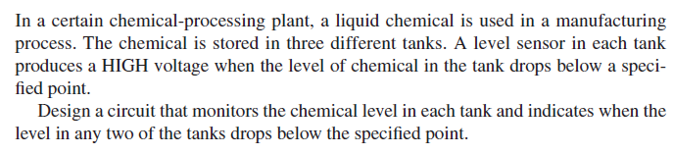
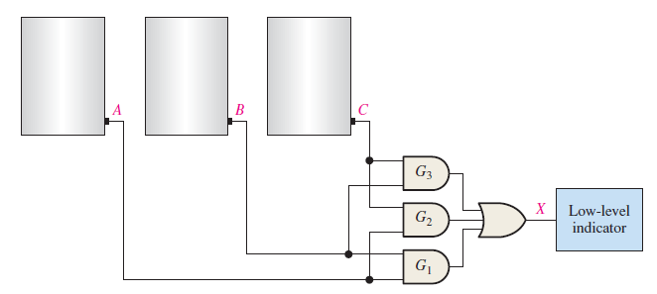
Basic Combinational Logic Circuits

Slide 8
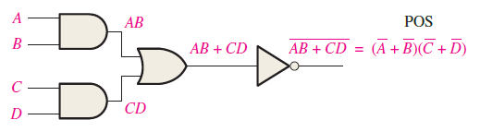
Basic Combinational Logic Circuits
When the output of a SOP form is inverted, the circuit is called an AND-OR-Invert (AOI) circuit. The AOI configuration lends itself to product-of-sums (POS) implementation.\
An example of an AOI implementation is shown. The output expression can be changed to a POS expression by applying DeMorgan’s theorem twice.

Slide 9
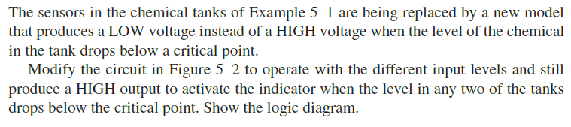
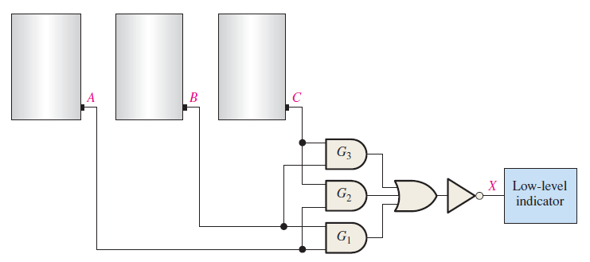
Basic Combinational Logic Circuits

Slide 10
Basic Combinational Logic Circuits
The truth table for an exclusive-OR gate is
Notice that the output is HIGH whenever A and B disagree.
X = AB + AB
X = A⊕ B
The Boolean expression is
The circuit can be drawn as
A
Symbols:
X
Distinctive shape Rectangular outline
B

Slide 11
Basic Combinational Logic Circuits
The truth table for an exclusive-NOR gate is
Notice that the output is HIGH whenever A and B agree.
The Boolean expression is
X = AB + AB
The circuit can be drawn as
A
Symbols:
X
B
Distinctive shape Rectangular outline

Slide 12
Basic Combinational Logic Circuits
Example
For each circuit, determine if the LED should be on or off.
(a) (b) (c)
Solution
Circuit (a): XOR, inputs agree, output is LOW, LED is ON.
Circuit (b): XNOR, inputs disagree, output is LOW, LED is ON.
Circuit (c): XOR, inputs disagree, output is HIGH, LED is OFF.

Slide 13
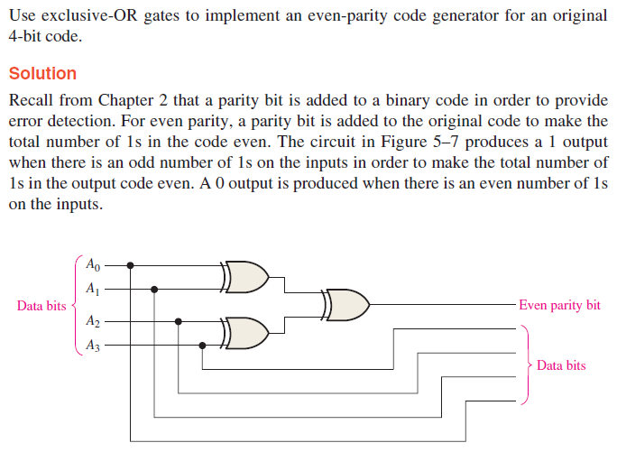
Basic Combinational Logic Circuits

Slide 14
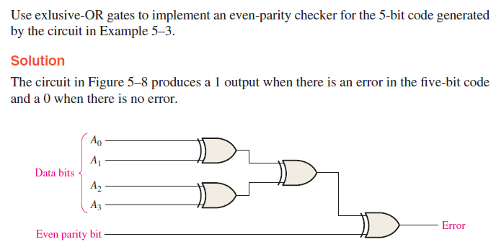
Basic Combinational Logic Circuits

Slide 15
Implementing Combinational Logic
Implementing a SOP expression is done by first forming the AND terms; then the terms are ORed together.
Example
Show the circuit that will implement the Boolean expression X = ABC + ABD + BDE. (Assume that the variables and their complements are available.)
Solution
Start by forming the terms using three 3-input AND gates.
Then combine the three terms using a 3-input OR gate.
A
B
C
A
X = ABC + ABD + BDE
B
D
B
D
E

Slide 16
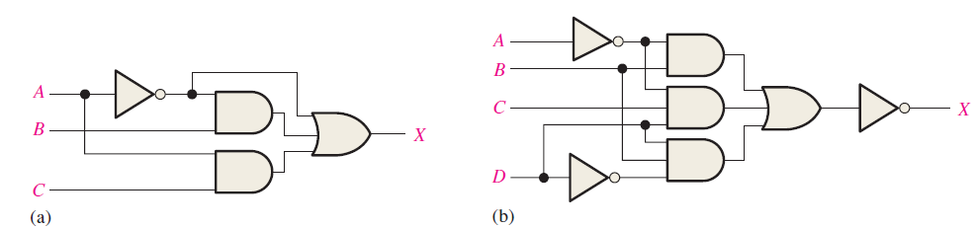
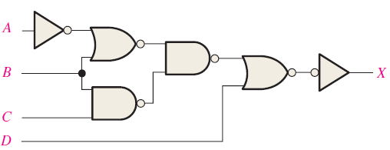
Exercise
Draw the ANSI distinctive shape logic diagram for a 4-wide, 3-input AND-OR-Invert circuit. Also draw the ANSI standard rectangular outline symbol.
Write the output expression for each circuit
Write the output expression for each circuit as it appears in next figure and then change each circuit to an equivalent AND-OR configuration.

Slide 17
References
Null, Linda (2024). "The essentials of computer organization and architecture". 6th edition. Jones & Bartlett Learning, Burlington, Massachusetts. ISBN: 9781284259438..
Thomas L. Floyd. (2014). “Digital Fundamentals”. 11th Edition. Prentice Hall. New Jersey. ISBN: 978-0132737968.
Combinational Logic circuits: https://www.electronics-tutorials.ws/combination/comb_1.html
Combinational logic design: https://www.javatpoint.com/combinational-logic-circuits-in-digital-electronics

